Slide 1
Capstone Project 4 Spotify trends ANALYSIS
Presented By:
Laksmi Priya M
MBM6

Slide 2
Problem Statement:
The objective of this project is to utilize Power BI's data visualization capabilities to analyze and present insights from Spotify data. This project seeks to leverage Power BI’s visualization capabilities to transform raw Spotify data into meaningful and interactive visualizations that enable users to gain insights, make data-driven decisions, and explore their music preferences in a visually engaging manner. As an analyst come up with the recommendation on suggesting advertisement s to stay competitive in music industry.

Slide 3
A Description
Here's a short description for your Spotify project: Spotify Data Analysis for Competitive Advertisements This project utilizes Power BI to analyze and visualize Spotify streaming data, focusing on generating insights to inform competitive advertisement strategies.
Primary Data Source: Spotify data
File Type: CSV File
Key Columns:
Date
Track Name
Track URL
Position
Artist
Country
Streams

Slide 4
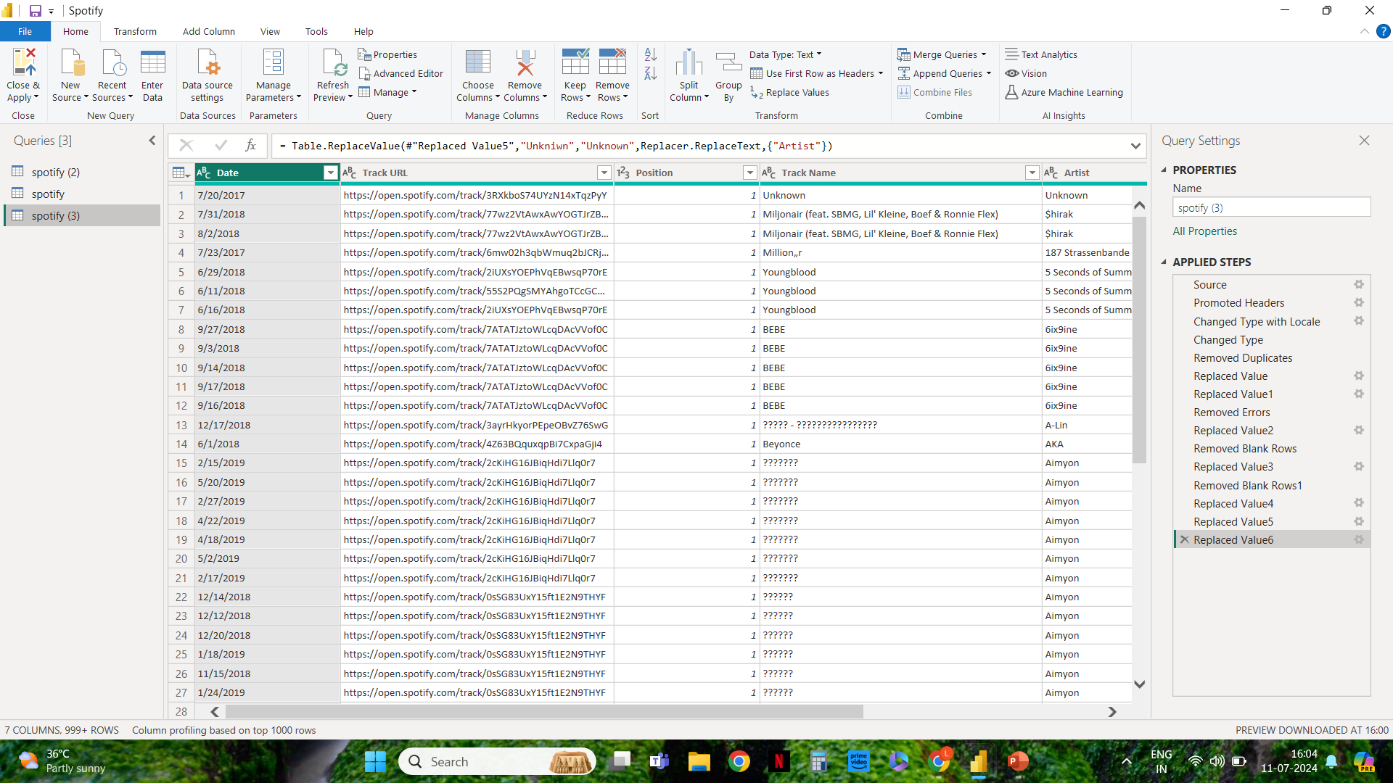
Documentation Of Cleaning and Manipulation Of Data

Slide 5
A Summary Of Your Analysis
Objective:
The project aims to provide recommendations for advertising strategies that will help stay competitive in the dynamic music industry by understanding consumer behavior, preferences, and trends as reflected in the Spotify data.
Key Steps in the Analysis
Data Preparation and Cleaning:
Imported the Spotify data.
Cleaned the data by removing duplicates and handling missing values.
Ensured proper data types for all fields.
Grouped rows of Artist and Track Name to create new column for count of respective columns.

Slide 6
Identified the Top artist , top Tracks.
Analyzed Stream, position, Top Tracks, Artist with Stream.
Conclusion:
Through an exploratory data analysis of Spotify streaming data, several key insights and trends have been identified to inform competitive advertising strategies. The analysis reveals that certain regions exhibit higher streaming activity, indicating prime targets for localized advertisements.
By leveraging these insights, Spotify can enhance its advertising strategy, ensuring it remains competitive and relevant in the ever-evolving music industry.

Slide 7
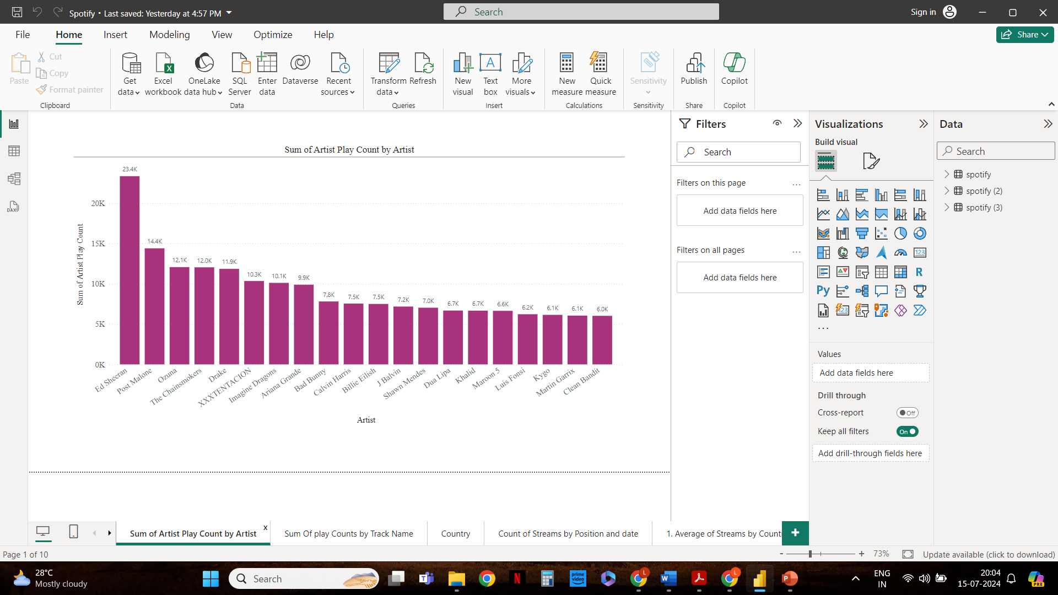
Supporting visualizations
Sum of Artist Play Count by Artist

Slide 8
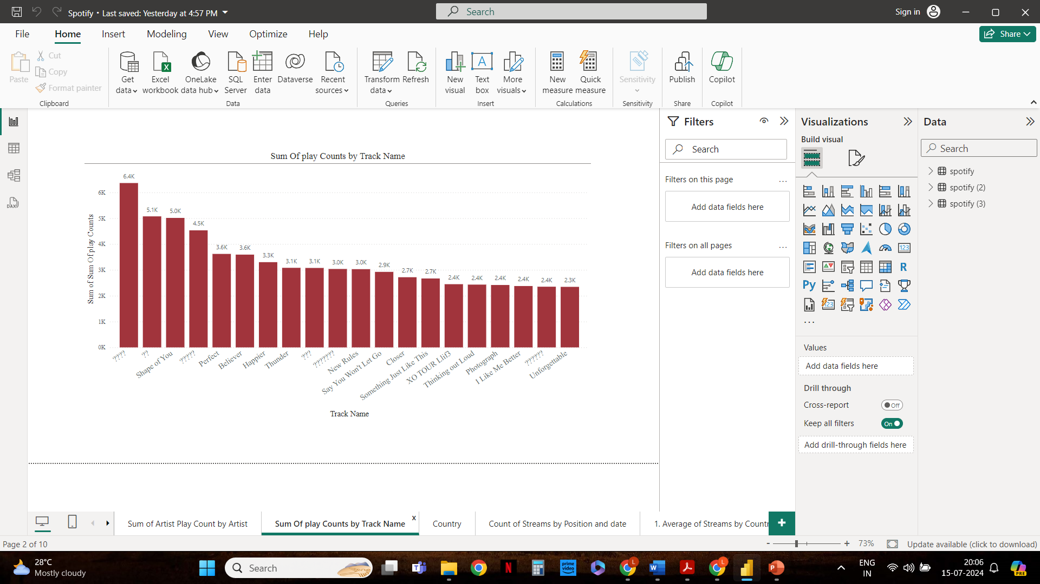
Sum Of play Counts by Track Name

Slide 9
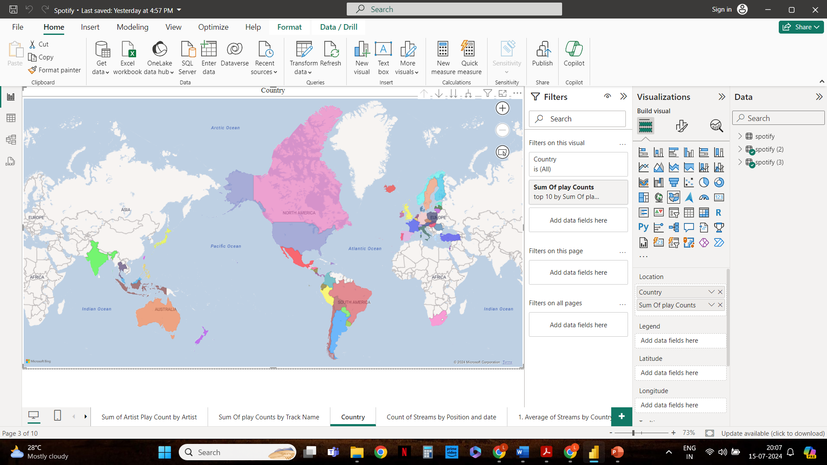
Country

Slide 10
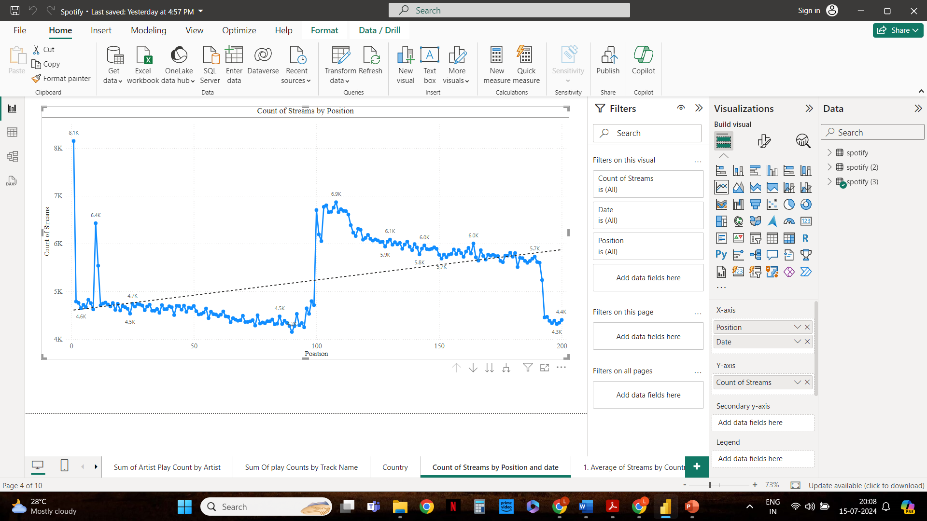
Count of Streams by Position and date

Slide 11
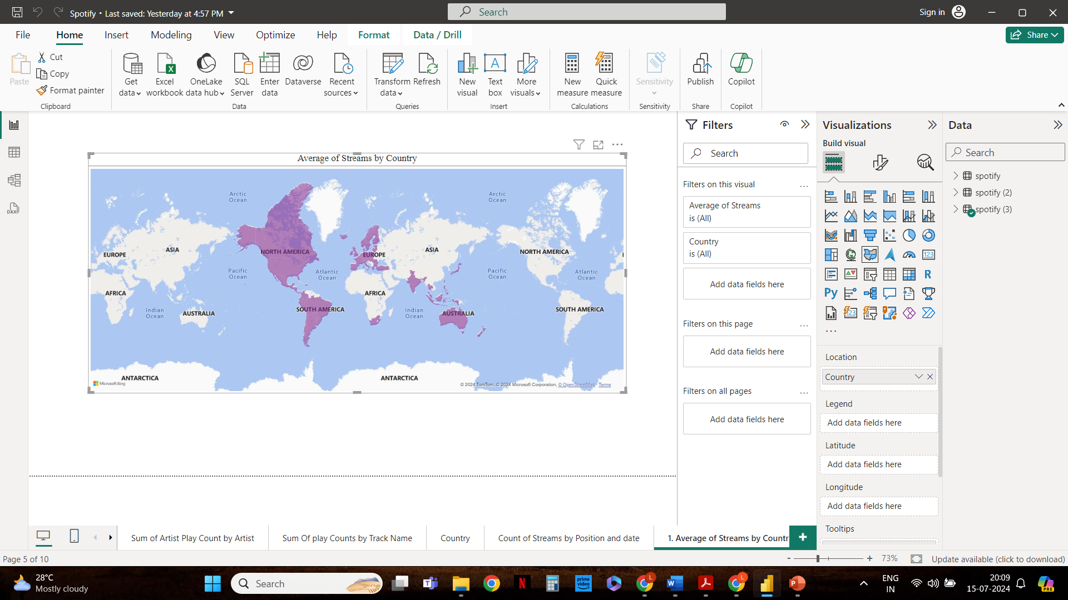
Average of Streams by Country

Slide 12
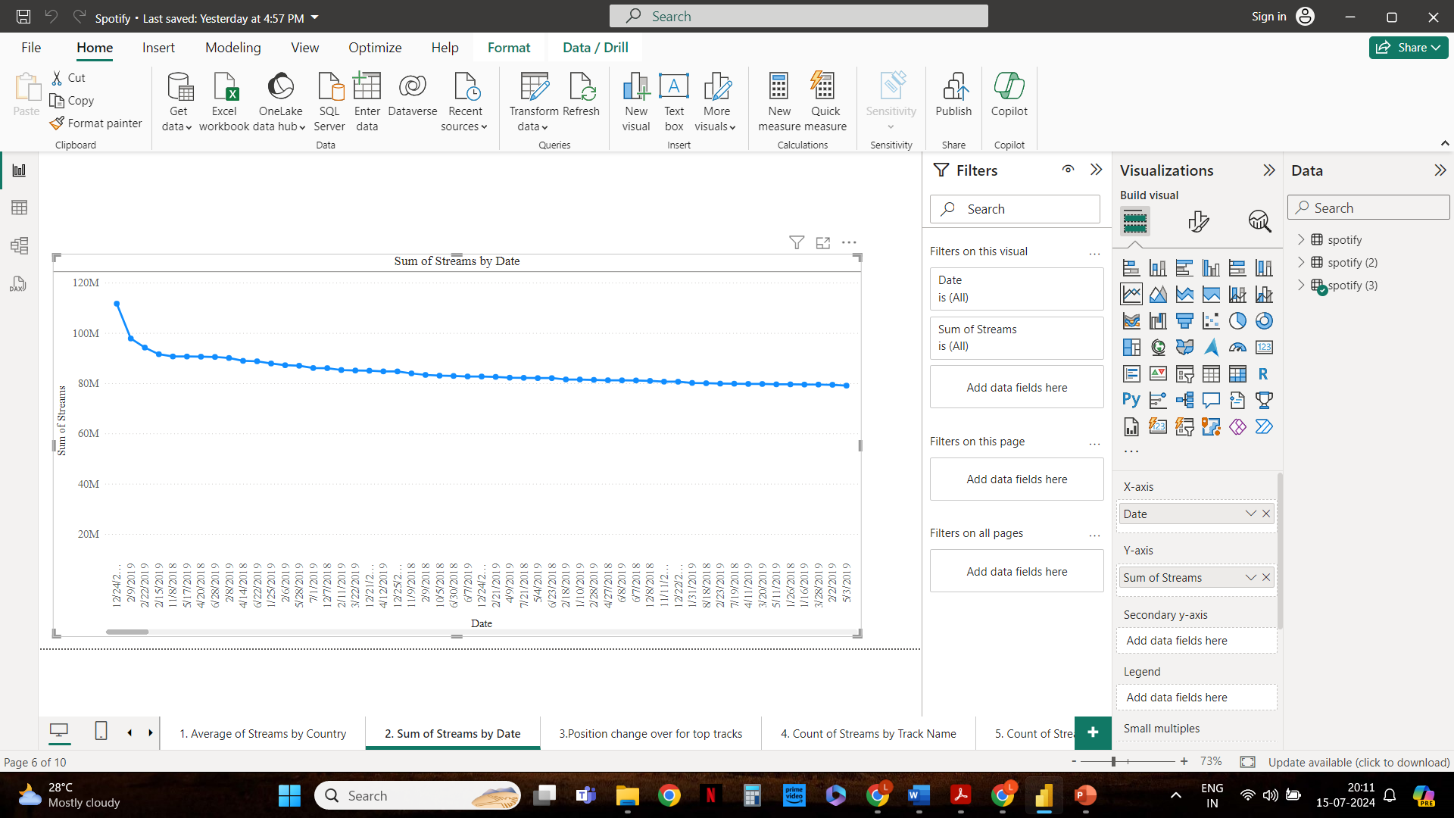
Sum of Streams by Date

Slide 13
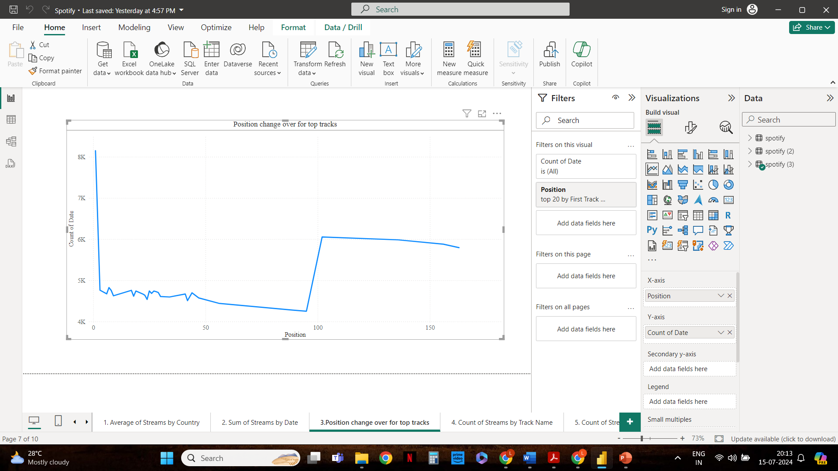
Position change over for top tracks

Slide 14
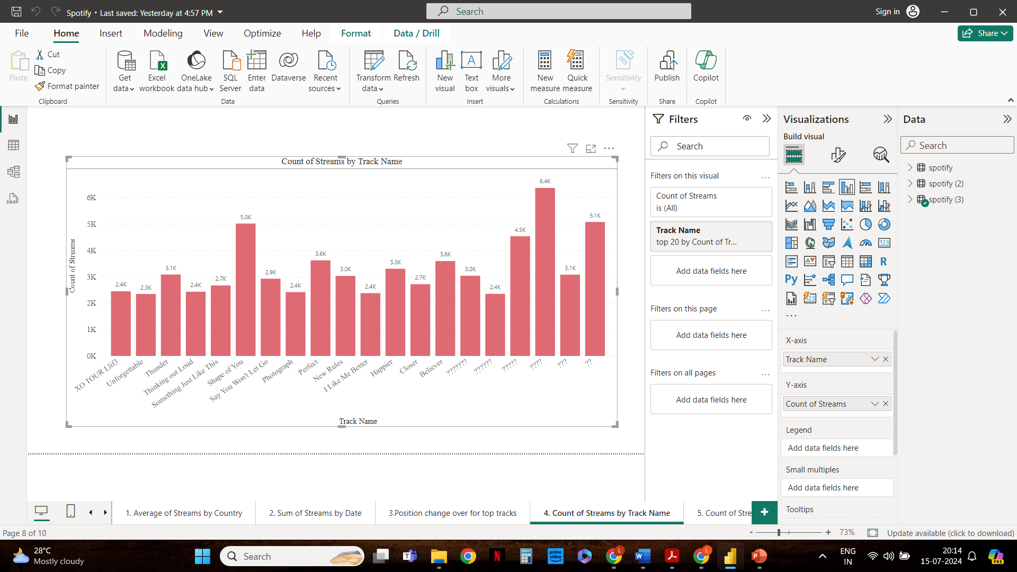
Count of Streams by Track Name

Slide 15
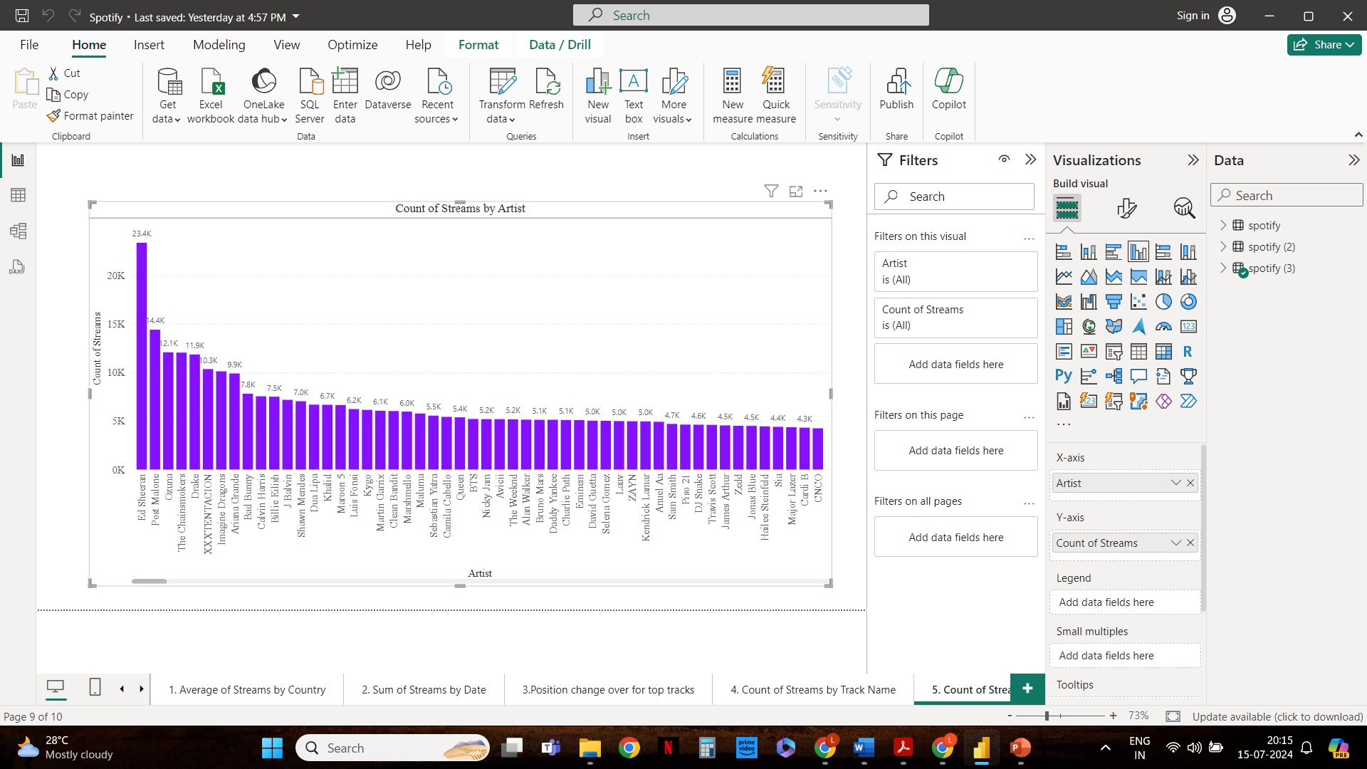
Count of Streams by Artist

Slide 16
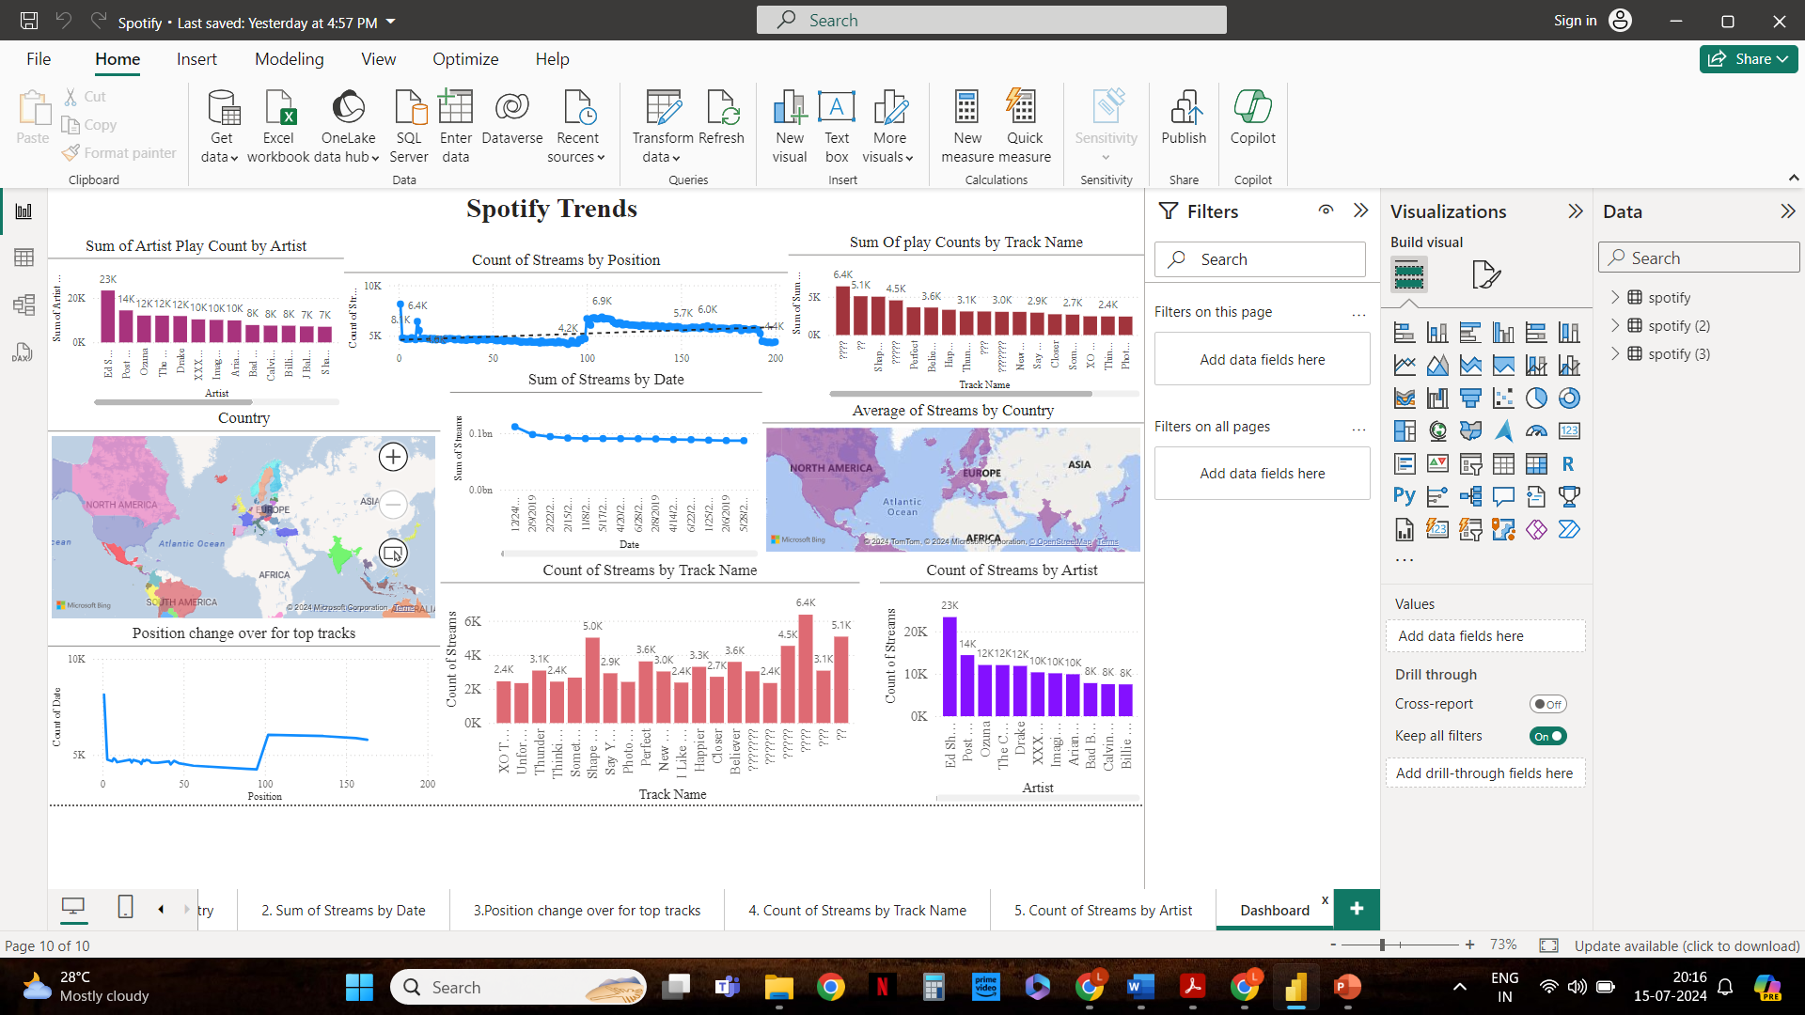
Dashboard

Slide 17
Analysis and Recommendation for Creating Advertisements Strategy
Total Streams per Country:
Insight: Regions with high streaming activity are prime targets for advertisements.
Ad Strategy: Focus advertising efforts on countries with the highest stream counts. Customize ads to fit the cultural context and preferences of these regions.
Top Artists by Streams:
Insight: Popular artists attract a large number of listeners, making their tracks valuable for ad placements.
Ad Strategy: Partner with top artists for sponsored content and advertisements. Place ads in playlists featuring these artists to maximize reach.

Slide 18
3. Top Tracks by Streams:
Insight: Tracks with the highest streams are popular and widely listened to.
Ad Strategy: Insert ads in playlists containing these top tracks. Use insights from these tracks to inform the genre and style of advertisements to align with listener preferences.
4. Streams Over Time:
Insight: Identify peak streaming times to target ads when user activity is highest.
Ad Strategy: Schedule advertisements during peak streaming periods to ensure maximum visibility. Adjust ad frequency to coincide with these high-activity periods.
5. Position Change Over Time for Top Tracks:
Insight: Tracks with improving positions are gaining popularity, indicating growing user interest.
Ad Strategy: Target ads to users who are listening to these rising tracks. Utilize the momentum of these tracks to introduce new advertisements and products.

Slide 19
Thank You

